Slide 1


500 Pv cercle
Srinivas Jala
(DUCD)

Slide 2
Why are you doing business ?
1.LONG TIME
2.SASTANEBLE
3.PROFETEBLE
4.DUPLICABLE

Slide 3
Why – 500 PV Circle
We are in turnover based business
The most important aspect of any business – sales/ volume/ Turnover
100 PV – Consumer Mindset
500 PV – Business Man Mindset
Complete 500 PV – 1st week or every Month
Maintain Customer record ( 20-30 loyal consumer), CNC
Keep Stock – 15-20 k in your House

Slide 4
WHY 500PV CERCLE
BUSINESS START
HOW TO CREAT 1 LAKH INCOME
30 PV – 10 YEARS
100 PV - 5 YEARS
160 PV – 2 TO 3 YEARS
300 PVS – 1 TO 2 YEARS
500 PVS - 6 MONTHS TO 1 YEAR.

Slide 5
HOW TO ACHIVE 1 LAKH INCOME WITH IN 1 YEAR
 | TRADITIONAL BUSINESS | VESTIGE BUSINESS
Investment | 10 L | 20 K
Risk | Yes | No
Time | 8 to 12 hours | Time Freedom; Save time
Manpower | Yes | No
Profit | Limited Income | Unlimited Income
Compition | Yes | NO

Slide 6
BENIFETS OF 500PV (16000/-Rs Products)
1.MRP Dis - 10 to 20 % 2400/-
2.Cash Back 8% 700/-
3. Free products 10% 1600/-
4.CNC offer 3000/-(mrp)
Total 7700/-
5. Fast track 8 % 750/-
G.Total 8450/-

Slide 7
1st Month
Y
500 pvs Self
A
B
C
D
E
F
G
H
500 pv
500 pv
500pv
500 pv
500 pv
500 pv
500 pv
500 pv
1 x 500 pv = 500 pvs
8 x 500 pv = 4000 pvs
TOTAL PVS 4500 pvs Fast Track Bronze Director
15000/-

Slide 8
HOW TO CREATE A PRESENTER
Dream Chat
Be A Presenter
Connect with WT System ( Zoom , Open Meeting, CEP,& Tools Ect…)
PAC
Create 500 PV Momentum in Your Team
Recognition 500 PV
Complete Your 500pv CNC Days (2 to 5)
Create the Loyal Customer (Min 10 Loyal Customers)

Slide 9
2 nd Month
Y
500 pvs Self
500 pv
500 pv
500pv
500 pv
500 pv
500 pv
500 pv
500 pv
8 x500 =4000pvs
8 x500 =4000pvs
8 x500 =4000pvs
8 x500 =4000pvs
8 x500 =4000pvs
8 x500 =4000pvs
8 x500 =4000pvs
8 x500 =4000pvs
1 x 500 = 500 PVS
8 x 500 = 4000 pvs
64 x 500 = 32000 pvs
Total pvs = 36500 pvs

Slide 10
3 nd Month
Y
500 pvs Self
500 pv
500 pv
500pv
500 pv
500 pv
500 pv
500 pv
500 pv
8 x500 =4
000pvs (64X8 = 512) members
1 x 500 = 500pvs
8 x 500 = 4000 pvs
64 x 500 = 32000 pvs
512x500 = 256000 pvs
Total pvs = 292500pvs
Income 4 to 5 L
Pin :UCD

Slide 11
BENFETS
100 % Products use
100 % Meetings
Stability in the business
Right Duplication
Multiple Growth
Balancing width & Depth
No side Volume Problem

Slide 12
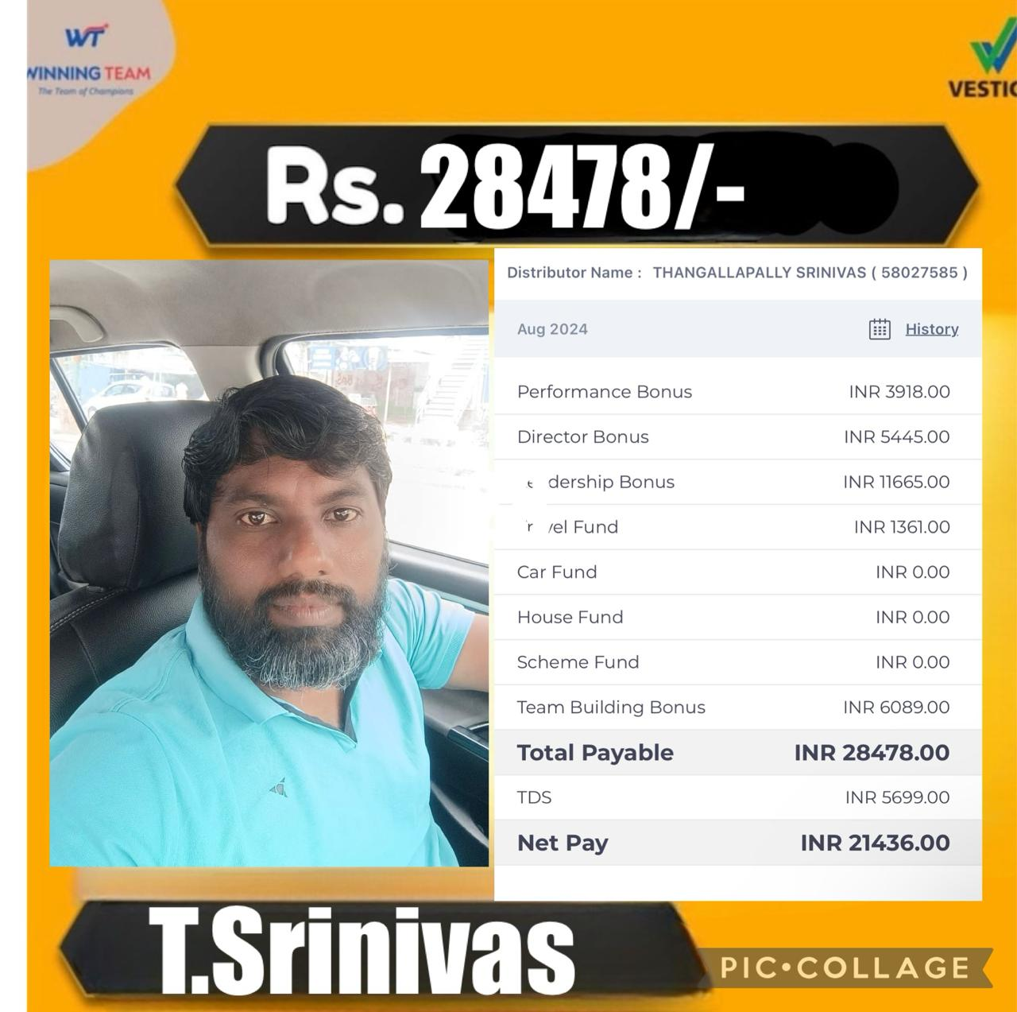
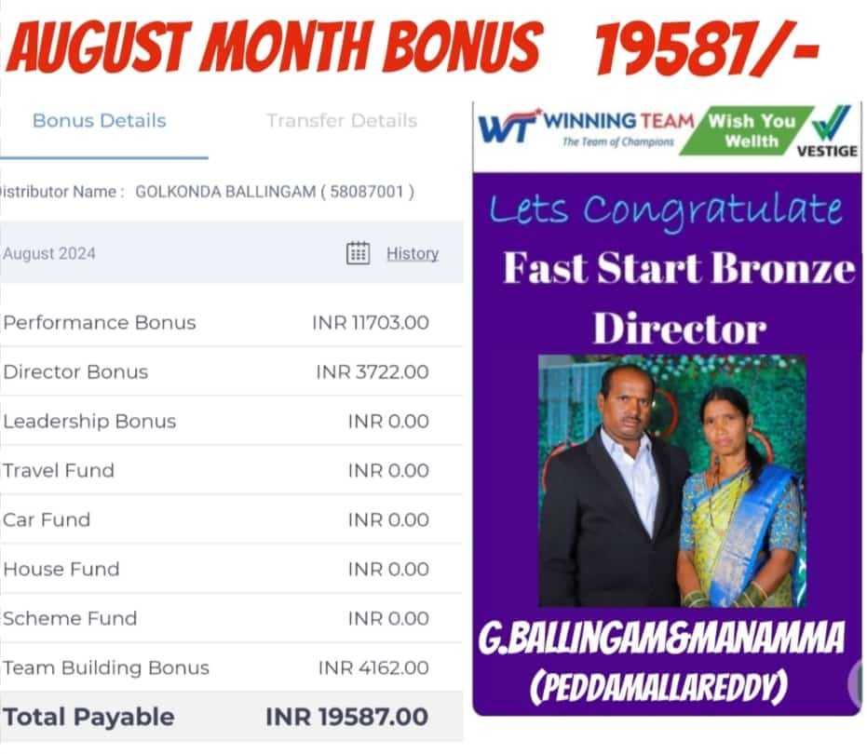
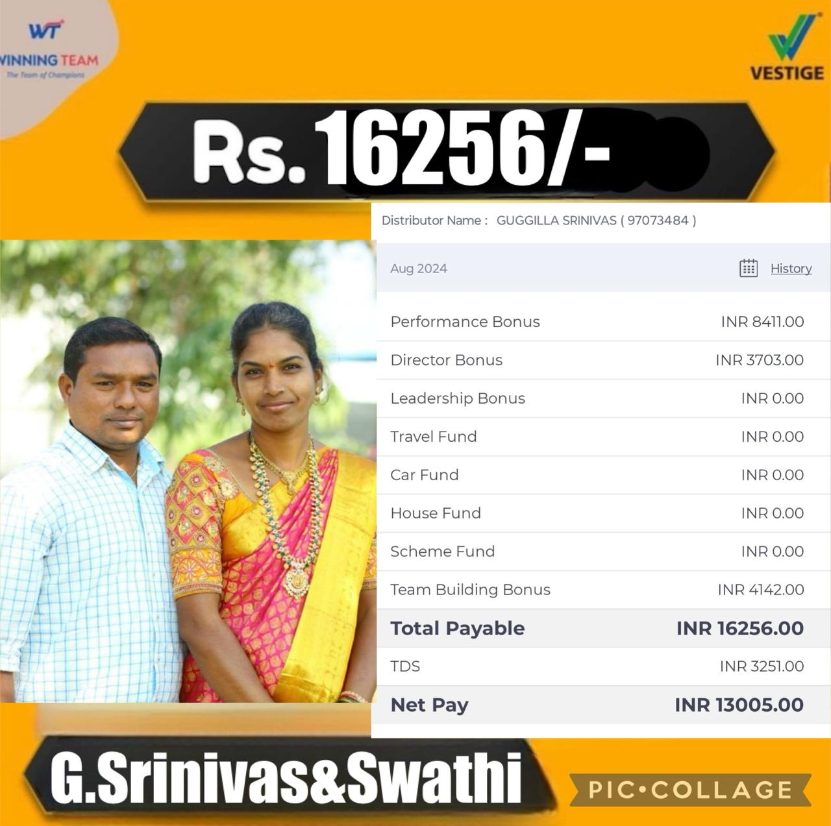
500 pvs Achivars

Slide 13
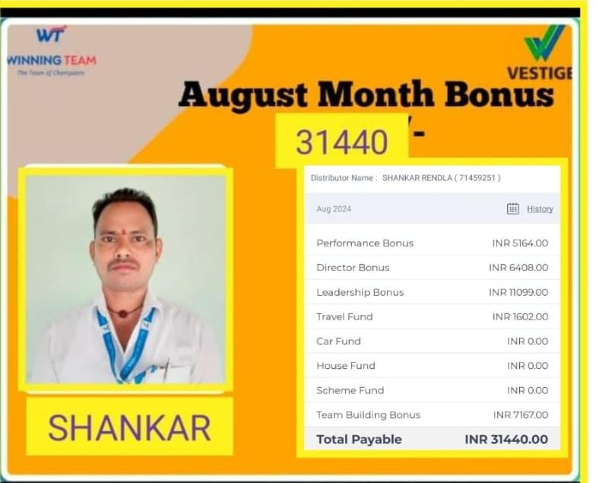
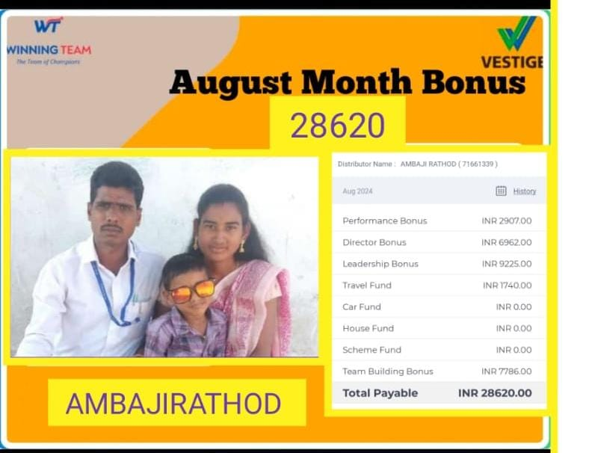
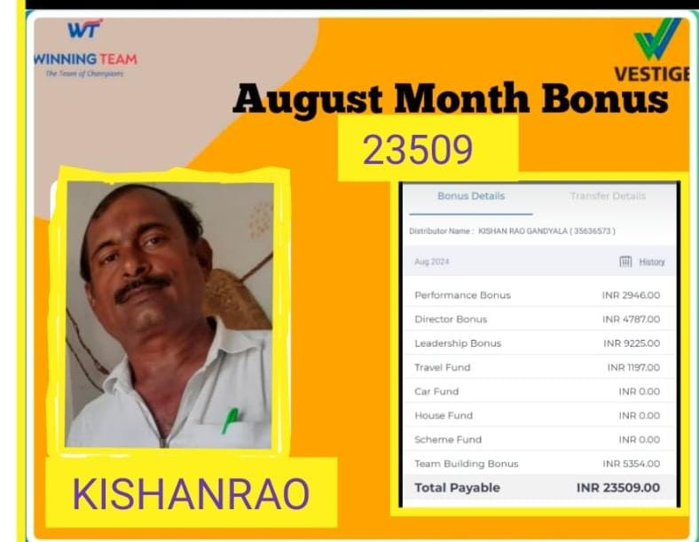
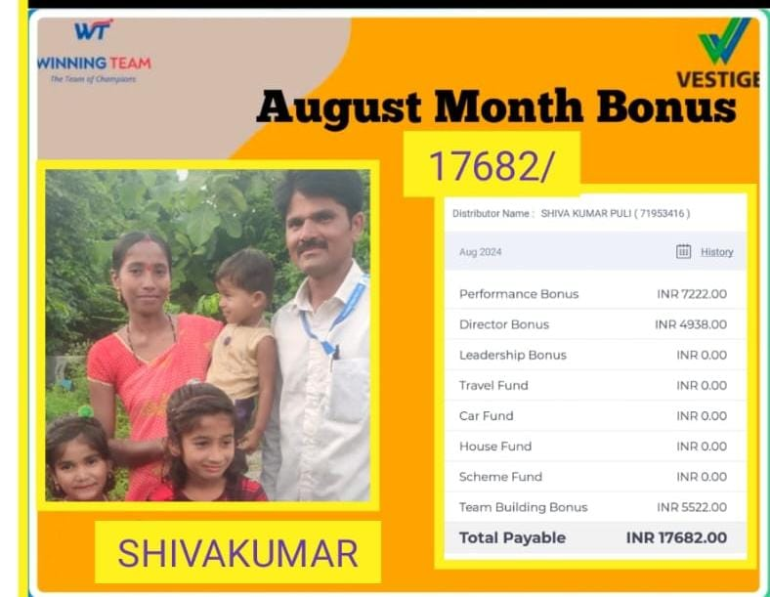
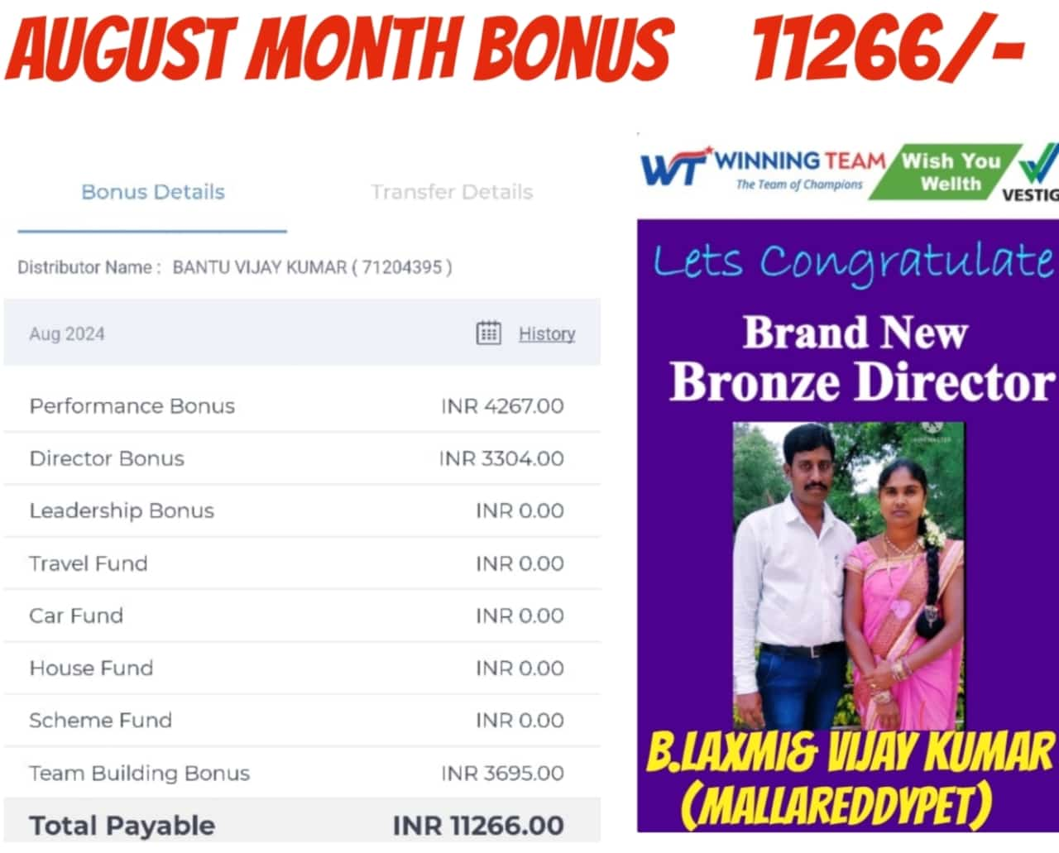
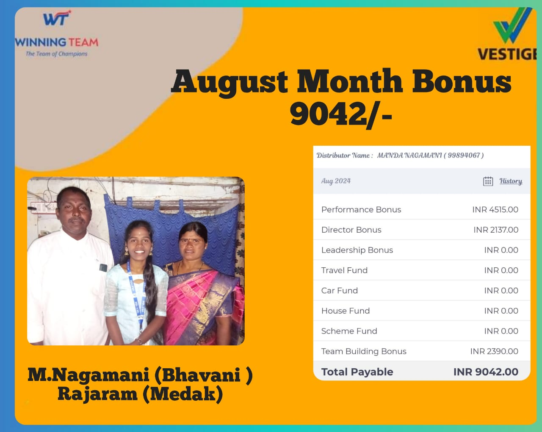

Slide 14
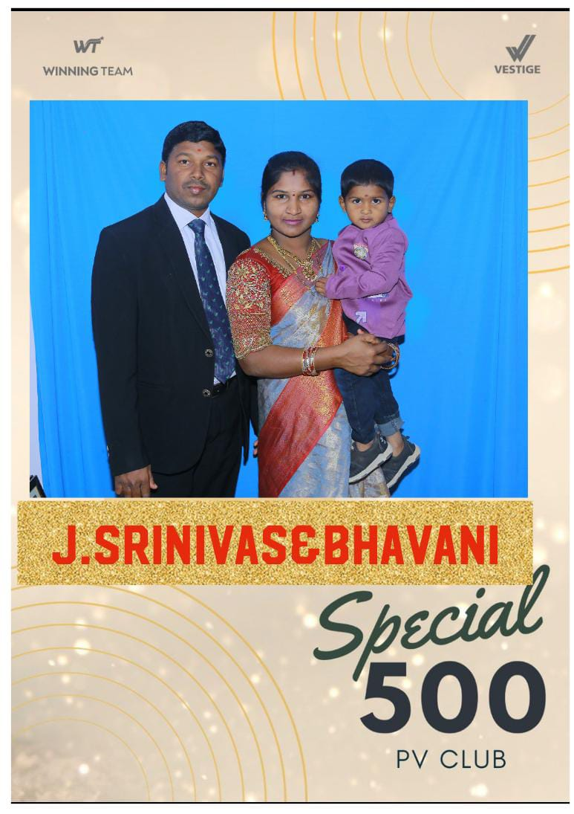






















Slide 15


